Slide 1
OVERVIEW
[Delete this slide from your presentation]
Roles and Responsibilities of team members (2)
Project Overview & Product Concept (6)
Requirements Overview – Per baseline SRD (6)
Requirements Completion Summary/Analysis (green, yellow, red button next to requirements)
Design Overview (5)
Summarize ADS and DDS, design trade-offs (key!)
Test Results (1)
Achievements Summary (3)
Major accomplishments vs. goals
TEAM Lessons Learned (2)

Slide 2


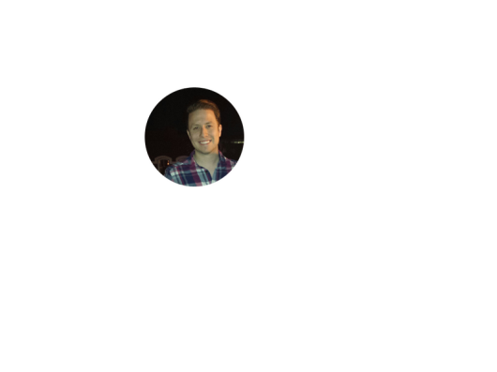


Project: Home Irrigation Control System (HICS) Team: SmartGrass
CSE Senior Design
Final Prototype Presentation
CSE 4317
Belachew
Haile-Mariam
Gautam
Adhikari
Jeremiah
O’Connor
Tung
Vo
Notes:
This presentation demonstrates the new capabilities of PowerPoint and it is best viewed in Slide Show. These slides are designed to give you great ideas for the presentations you’ll create in PowerPoint 2010!
For more sample templates, click the File tab, and then on the New tab, click Sample Templates.

Slide 3
ROLES AND RESPONSIBILITIES OF TEAM MEMBERS
1
Belachew

Slide 4
Roles and Responsibilities of Team Members
Individual | Role | Responsibility
Belachew Haile-Mariam | - Team Member - Project Manager - Hardware Lead | - Manage Project Plan - Delegate Tasks - Hardware Integration - Program low level code
Gautam Adhikari | - Team Member - Risk Manager - Application Developer | - Notify team of possible risks - Aid in software tasks - Manage database queries
Jeremiah O’Connor | - Team Member - Document Master - Software Lead | - Document Formatting - Lead web application development
Tung Vo | - Team Member - Quality Assurance Lead - Application Developer | - Perform testing as needed - Aid in hardware tasks - Program low level code
Keith Aholt | - Project Sponsor | - Provide feedback relating to project requirements
Mike O’Dell | - Project Supervisor | - Oversee project and ensure that we are on track

Slide 5
PROJECT OVERVIEW
2
Belachew

Slide 6
Project Overview – SDI & SDII
Our project was split into two parts:
Senior Design I (Fall Semester)
Identified our team and project (Project Charter)
Gathered requirements from our sponsor (SRS)
Began designing our project’s architecture (ADS)
Senior Design II (Spring Semester)
Finished designing our project’s architecture (ADS)
Designed the low level details for our project (DDS)
Developed a test plan (STP)
Implemented of our final product prototype

Slide 7
Project Overview – Internal Controls
The internal controls for our project were the main objective of the Project Manager.
He delegated tasks to the team members and maintained a project plan to keep the team on track.
Any alterations to the project plan first required approval from the project manager.

Slide 8
Project Overview – External Controls
External controls of our project were provided in the following forms:
Team Status Reports
Individual Status Reports
Document Submissions
Gate Reviews

Slide 9
Project Overview – Constraints and Assumptions
The main constraints throughout the course of this project were:
Limited Time and Budget
Limited Knowledge
Other Obligations
The main assumptions made going into this project were:
Effective Leadership
Team Effort
Constant Communication

Slide 10
PRODUCT CONCEPT
3
Tung

Slide 11
Product Concept - Purpose
Design and create a device for users to monitor and control the watering of their home irrigation system.
Allow users to view information about their local watering environment, such as soil moisture levels, temperature readings, and rain status.
Provide users with a mechanism to be able to create and edit watering schedules, toggle their device on or off, and view the device’s health status via an online web interface.

Slide 12
Product Concept - Definition
The Home Irrigation Control System (HICS) will be a device that users can connect to their home sprinkler system to the Internet.
The customers will be able to attach their existing sprinkler valve wires to the HICS product.
Once the initial installation is complete, the user will be required to go online and register their product through our website.
After this setup process is complete, the user will be able to view and interact with their home’s watering system through an online dashboard at any time.

Slide 13
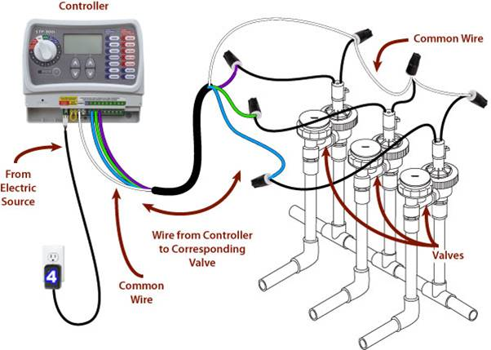
Product Concept – Mock Up
A regular home irrigation system.

Slide 14
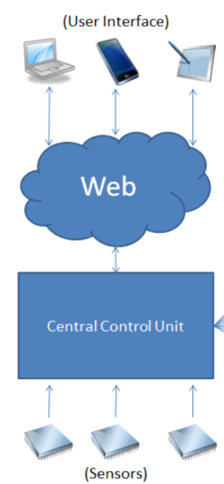
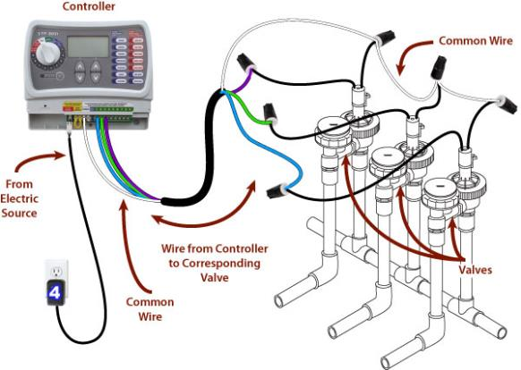
Product Concept – Mock Up
A conceptual model of our product!

Slide 15
Product Concept - Intended Audience
The intended audience for our home irrigation control system will be homeowners who water their lawns on a regular basis. In particular, this device will be especially marketed towards homeowners in hot climates, such as the southern and southwestern United States.

Slide 16
REQUIREMENTS OVERVIEW
4
Gautam

Slide 17
Requirements Overview – Customer Requirements
Req # | Name | Description | Status
3.1 | Central Control Unit | Responsible for communication between the web application, soil moisture sensors, and water valves | Completed
3.2 | Soil Moisture Sensors | In-ground sensors that monitor and report soil moisture levels | Completed
3.3 | Web Application | Lets the user interface with the control unit and adjust the watering valves based on sensor data | Completed
3.4 | Watering Scheduler | Lets user set-up schedule for watering | Completed
3.5 | Soil Moisture Reports | Generates reports based on soil moisture readings | Completed
3.6 | User Login | Lets user securely login and use HICS functions | Completed
3.7 | Active Status | Display letting user know if the system is Active or not. | Completed

Slide 18
Requirements Overview – Customer Requirements
Req # | Name | Description | Status
3.8 | Rain Sensor | Sensors that monitor and report soil Rain Status | Completed
3.9 | Web Hosting Service | A server hosting our web application | Completed
3.10 | Database Management System | Stores all data from soil sensor readings as well as all the information for the web application. | Completed
3.11 | Device Registration | Lets user register their HICS and interface HICS via the web application. | Completed
3.12 | Region Grouping | Allow the user to setup watering schedules for multiple zones at once without having to configure each individual zone. | Not Completed
3.13 | Auto Off | Shuts down the watering when not scheduled or ordered | Completed
3.14 | Temperature Sensor | Sensors that monitor and report Temperature Status | Completed

Slide 19
Requirements Overview – Packaging Requirements
Req # | Name | Description | Status
4.1 | Control unit Housing | Contains Control Unit & accessories mounted permanently | Completed
4.2 | Soil Moisture Sensors Packaging | Package containing soil moisture sensor | Completed
4.3 | Rain Sensor Packaging | Package containing rain sensor | Completed
4.4 | Connecting Cables | (1) Power cable and (1) Ethernet cable inside the final packaging of HICS | Completed
4.5 | Software Application | A stand-alone web application that requires no set up from the user. | Completed
4.6 | User Manual | Details containing use and operation of HICS | Completed
4.7 | Temperature Sensor Packaging | Package containing temperature moisture sensor | Completed

Slide 20
Requirements Overview – Performance Requirements
Req # | Name | Description | Status
5.1 | Sensor Accuracy | Accurate sensor reading is necessary for efficient watering schedules | Completed
5.2 | Rain Detection | In case of rain, the rain sensor must quickly transmit an alert to the control unit | Completed
5.3 | Communication between Web application & Central Control Unit | The user will be able to set watering schedules through the web application to send a signal to the central control unit to initiate watering. | Completed
5.4 | Communication between Soil Moisture Sensor and Central Control Unit | The soil moisture sensors will communicate with the central control unit to relay information about soil moisture | Completed
5.5 | Device Power Malfunction | If the server fails to receive communication from the central control it will notify the user that the system is offline. | Completed

Slide 21
Requirements Overview – Safety Requirements
Req # | Name | Description | Status
6.1 | Soil Moisture Sensor Insulation | The electronic components of the soil moisture sensors must be properly insulated against external environmental conditions. | Not Completed
6.2 | Central Control Unit Temperature | Efficient air flow and low temperatures must be established while the central control unit is in operation | Completed
6.3 | Proper Wiring of Central Conctol Unit | The central control unit will be powered from an external wall plug.. | Completed

Slide 22
Requirements Overview – Maintenance and Support Requirements
Req # | Name | Description | Status
7.1 | Sensor Maintenance | The all sensors will be replaceable in the event of hardware failure. | Completed
7.2 | Software Maintenance | All source code files and its documentation must be available for software maintenance and troubleshooting. | Completed
7.3 | Source Code Documentation | All source code files for HICS will be extensively commented to support future updates and troubleshooting | Completed
7.4 | Scalability | The central control unit will support adding additional valves or soil sensors. | Completed
7.5 | Troubleshooting Guide | A troubleshooting guide will be in the User Manual to help user figure out any problems | Completed

Slide 23
Requirements Overview – Other Requirements
Req # | Name | Description | Status
8.1 | Mapping the Soil Moisture Sensors to Irrigation Valves | HICS requires that the user properly maps soil moisture sensors to the irrigation valves | Completed
8.2 | Browser Support | The web application should support Mozilla Firefox, Google Chrome & Internet Explorer. | Completed
8.3 | Central Control Unit Mounting | The central control unit must be mounted in a location where it can interface with wires from all other hardware | Completed
8.4 | Rain Sensor Mounting | The rain sensor must be mounted so as to get rain when it’s raining. | Completed
8.5 | Application Security and Privacy | All user data and account information will be stored on a secure server. | Completed
8.6 | User Administration Account | There should be admin account to create, edit, and delete user accounts and their associated devices. | Completed

Slide 24
DESIGN OVERVIEW
5
Jeremiah

Slide 25
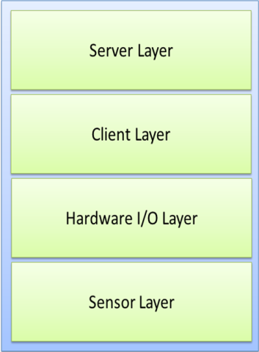
Design Overview – Architecture Design Specification
Guiding Principles
Scalability
Ease of Use
Maintainability
Compatibility
Interface Layer
HICS Layer Diagram

Slide 26
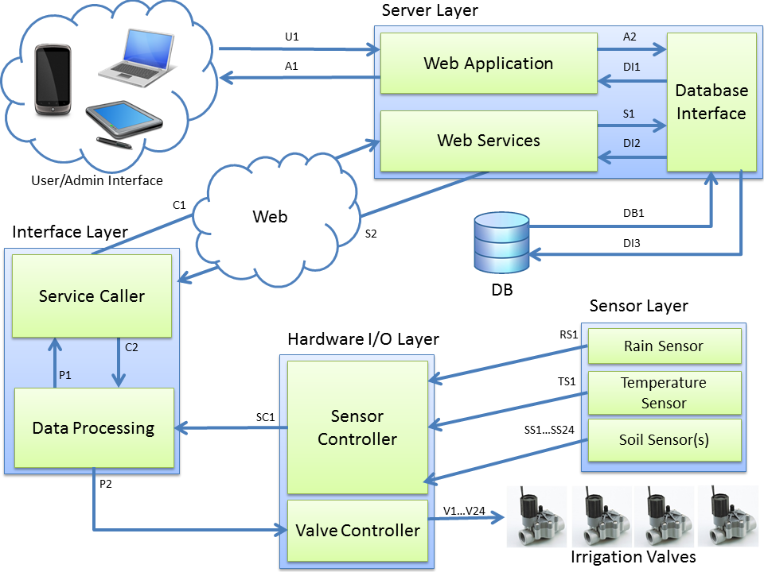
Design Overview – Architecture Design Specification
Inter-Subsystem Data Flow Diagram

Slide 27
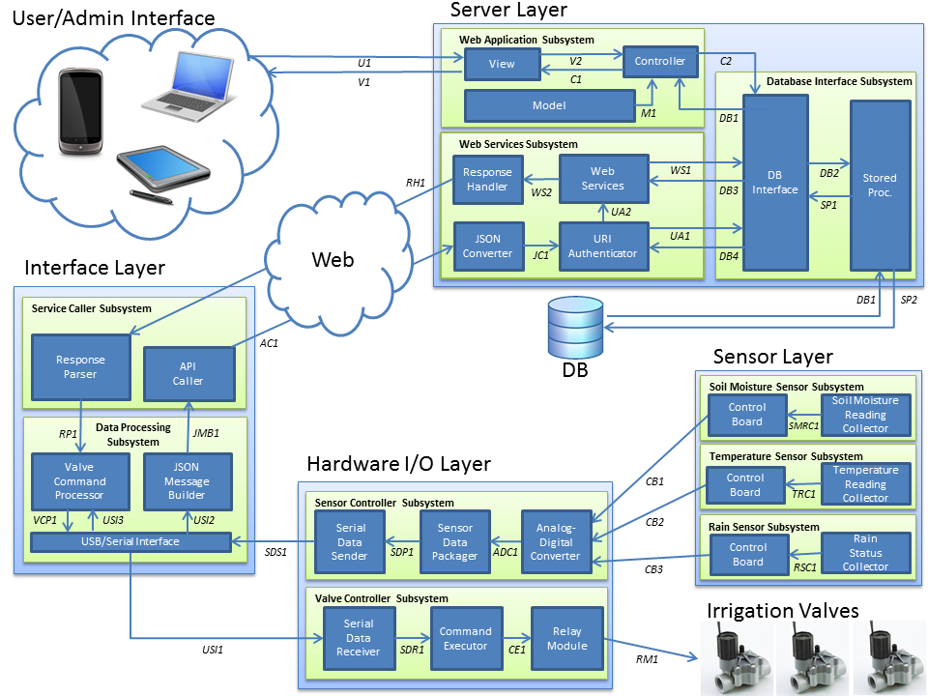
Design Overview – Detailed Design Specification
Architecture Overview Diagram

Slide 28
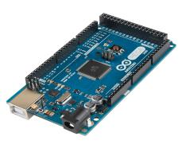
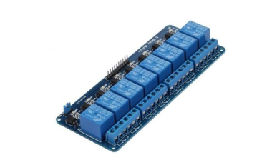
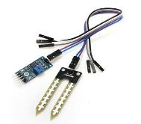
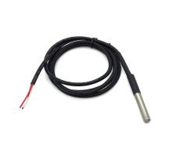
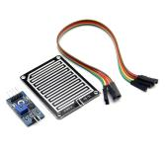
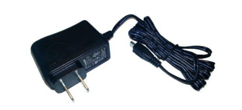
Design Overview – Detailed Design Specification
Main System Hardware Description
(1) Raspberry Pi B+ Microcomputer
(2) Arduino Mega Microcontrollers
(3) Relay Switch Modules
(3) Soil Moisture Sensors
(1) Temperature Sensor
(1) Rain Sensor
(4) AC Power Modules

Slide 29
Design Overview – Tradeoffs

Slide 30
TEST RESULTS
6
Jeremiah

Slide 31
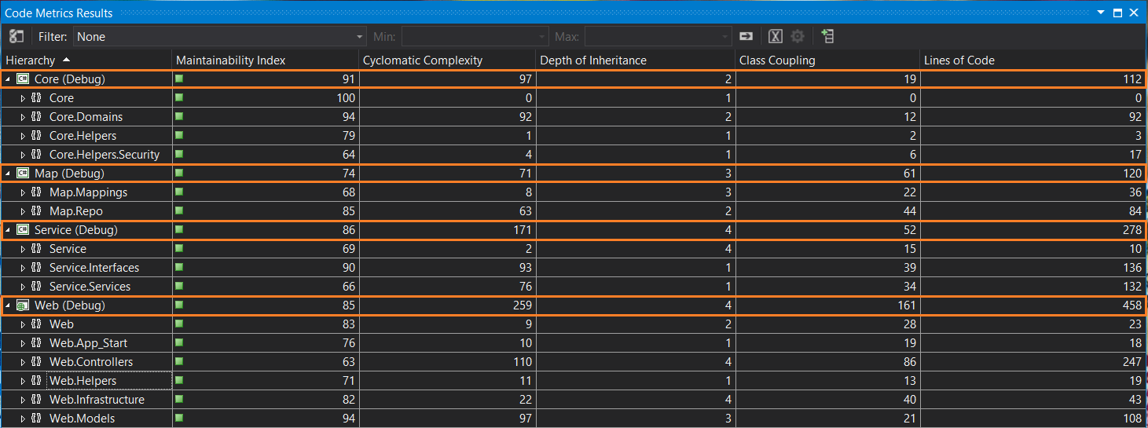
Test Results – Server Layer
Maintainability Index (0 - 100) – The relative ease of maintaining the code. A high value means better maintainability.
Cyclomatic Complexity – The number of different code paths in the program(s). This represents structural complexity.
Depth of Inheritance – Indicates the number of class definitions that extend to the root of the class hierarchy.
Class Coupling – Measures the coupling to unique classes throughout the program. High coupling indicates a design that is difficult to reuse/maintain.

Slide 32
Test Results – Interface Layer
Service Caller Subsystem
Our Raspberry Pi microcomputer was programmed in Python, and had a total of 55 SLOC.
Data Processing Subsystem (Arduino)
Our Arduino microcontroller was programmed in a C-like language, and had a total of 97 SLOC.

Slide 33
Test Results – Hardware and Sensor Layers

Slide 34
ACHIEVEMENTS SUMMARY
7
Tung

Slide 35
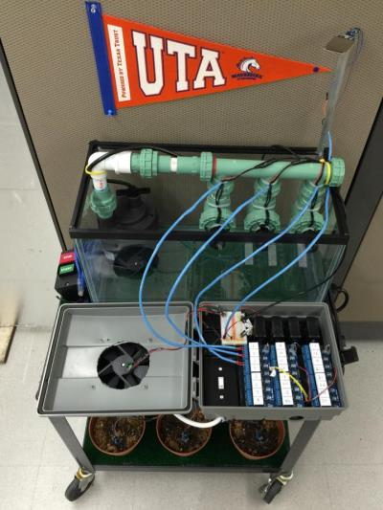
Achievements Summary – Control Unit

Slide 36
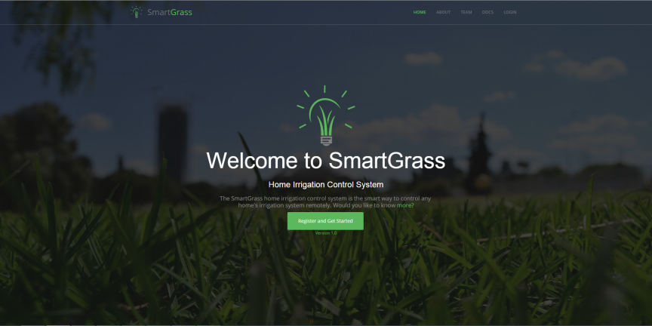
Achievements Summary – Web Portal

Slide 37
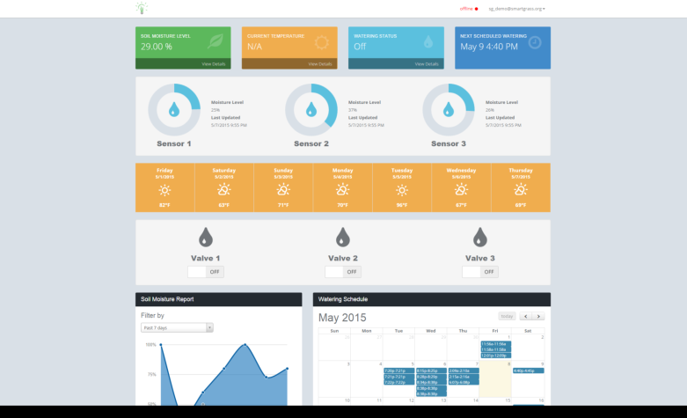
Achievements Summary – Dashboard

Slide 38
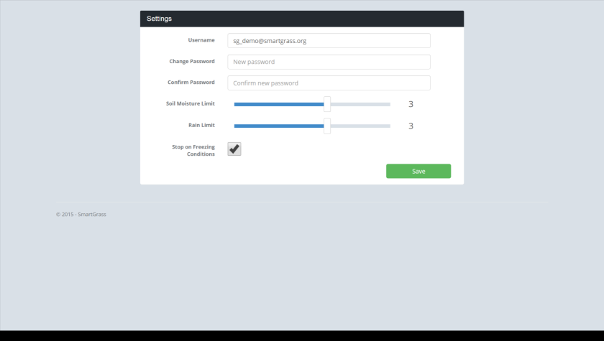
Achievements Summary – Settings Page

Slide 39
LESSONS LEARNED
8
Gautam

Slide 40
Lessons Learned – Senior Design I

Slide 41
Lessons Learned – Senior Design II
Backup files with a cloud-based service for easy syncing/sharing.
Plan to complete milestones before they are actually due.
Set mini-milestones that add up to bigger ones.
Define your project terminology early so that everyone is always on the same page.
Maintain good communication within the team.
Constantly look for feedback from your project stakeholders.
Keep an agenda for every meeting.

